Slide 1
Builder Pattern Humayun Ahmed Principal Software Engineer Cefalo School

Slide 2
Builder Pattern
Separate the construction of a complex object from its representation so that the same construction process can create different representations.
Use the Builder pattern when:
the algorithm for creating a complex object should be independent of the parts that make up the object and how they are assembled
the construction process must allow different representations for the object that is constructed

Slide 3
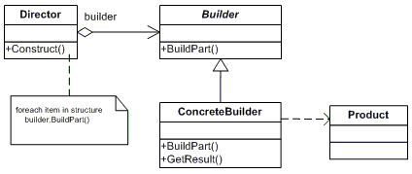
Builder Pattern

Slide 4
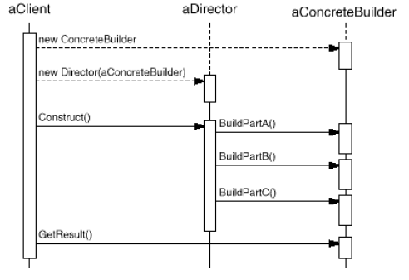
Collaboration

Slide 5
Homework
Suppose you are building an architecture tool. Your tool can draw Walls, Doors, Windows, Floors, Rooms. Now you want to give user a few standard house templates which they can pick and start modifying.
Use Builder Pattern to create Buildings for such templates.
Clue: IBuildingBuilder, ISingleStoryBuilder, IMultiStoryBuilder, ConcreteBrickHouseBuilder, ConcreteGlassHouseBuilder
IBuildingDirector, ThreeStoryBuildingDirector, DuplexDirector, GardenHouseDirector

Slide 6
References
http://www.dofactory.com/net/composite-design-pattern
Refactoring To Patterns by Joshua Kerievsky

